Slide 1

Dog Breed Identification Using Deep Learning
~ Under the guidance of- Prof. Prajyot Patil
Group Members-
Sayee Gosavi
Snehal Dimble
Shambhu Nangare
Amit Chavan

Slide 2
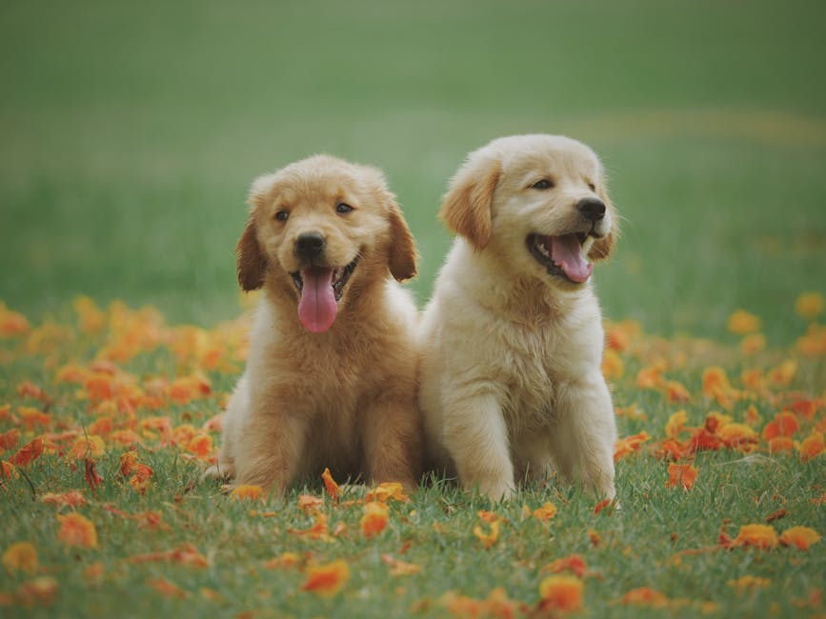
01
Introduction to Dog Breed Identification
02
Role of Deep Learning
Project Overview
03
Importance in Real-World Applications
04
Challenges in Identification
05
How CNNs Help in Classification

Slide 3
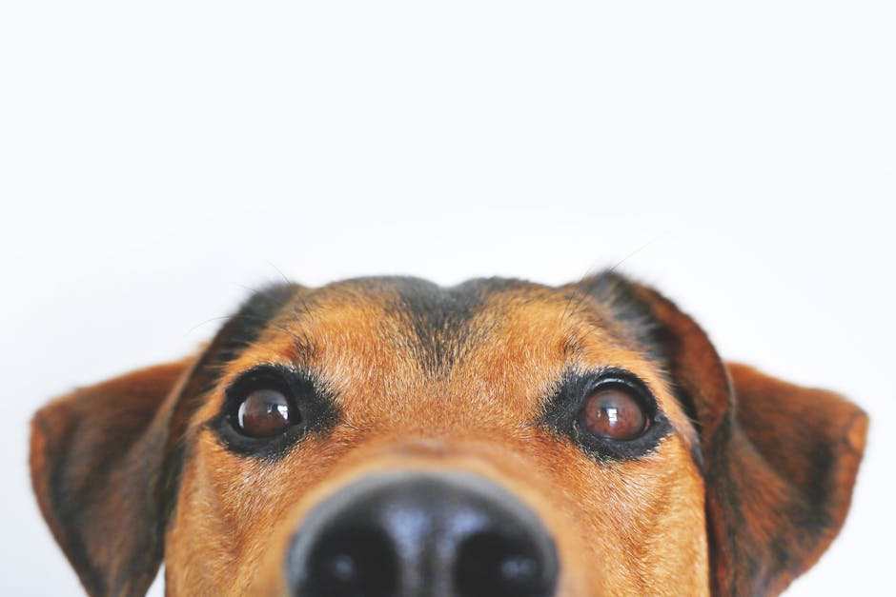
Problem Statement
Why is Dog Breed Identification Challenging?
Identifying dog breeds accurately is difficult due to similar-looking breeds, variations in fur color, and different angles of images.
Limitations of Traditional Methods
Traditional approaches rely on hand-crafted features that often fail to capture complex patterns, leading to inaccurate results.
How Deep Learning Solves This
Deep learning models, especially CNNs, can learn hierarchical features, allowing for more accurate and automated breed identification.

Slide 4
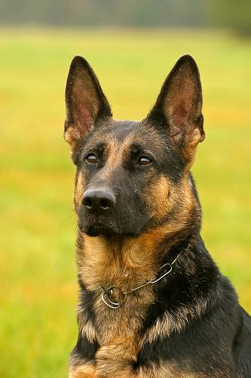

Methodologies Used
Dataset Collection & Preprocessing
Data was gathered from open-source datasets containing labeled dog breed images. Preprocessing included resizing, normalization, and data augmentation.
Training & Model Optimization
The model was trained using cross-entropy loss and optimized using Adam optimizer. Hyperparameter tuning improved accuracy.

Slide 5
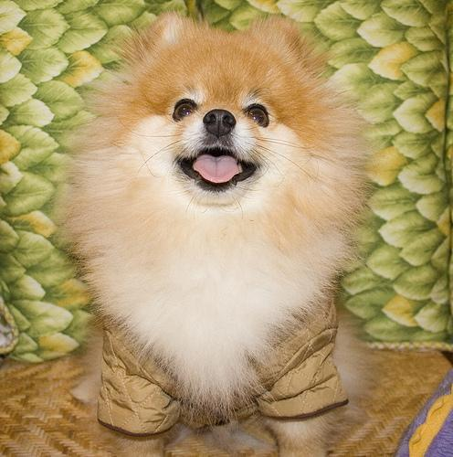

Advanced Algorithms
Transfer Learning Models
Pre-trained models like ResNet, VGG16, and MobileNet were used to improve classification accuracy while reducing training time.
Feature Extraction vs. Fine-Tuning
Feature extraction uses pre-trained weights, while fine-tuning adapts the model to the dataset by training additional layers.
Performance Comparison
Different models were tested, and MobileNet performed best for mobile applications due to its efficiency.

Slide 6
Applications of Dog Breed Identification
Pet Adoption & Rescue
Veterinary Diagnostics
Mobile Applications
Identifies stray dogs, helping shelters determine breeds and provide better care.
Assists veterinarians in diagnosing breed-specific health issues efficiently.
Used in apps for pet owners to identify dog breeds using smartphone cameras.

Slide 7
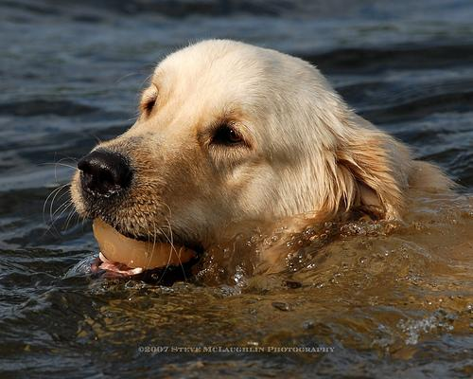
Research Papers and Studies
Name | Citation
Knowing your dog breed: identifying a dog breed with deep learning | Borwarnginn, P., Kusakunniran, W., Karnjanapreechakorn, S., & Thongkanchorn, K. (2021). Knowing your dog breed: identifying a dog breed with deep learning. International Journal of Automation and Computing, 18, 45-54.
Dog breed identification using deep learning | Ráduly, Z., Sulyok, C., Vadászi, Z., & Zölde, A. (2018, September). Dog breed identification using deep learning. In 2018 IEEE 16th International Symposium on Intelligent Systems and Informatics (SISY) (pp. 000271-000276). IEEE.
Identification of dog breeds using deep learning | Kumar, R., Sharma, M., Dhawale, K., & Singal, G. (2019, December). Identification of dog breeds using deep learning. In 2019 IEEE 9th International Conference on Advanced Computing (IACC) (pp. 193-198). IEEE.
Dog Breed Identification Using Deep Learning | Tuteja, A., Bathla, S., Jain, P., Garg, U., Dureja, A., & Dureja, A. (2023, June). Dog Breed Identification Using Deep Learning. In International Conference on Data Analytics & Management (pp. 515-530). Singapore: Springer Nature Singapore.

Slide 8
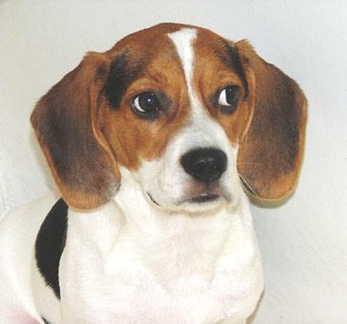
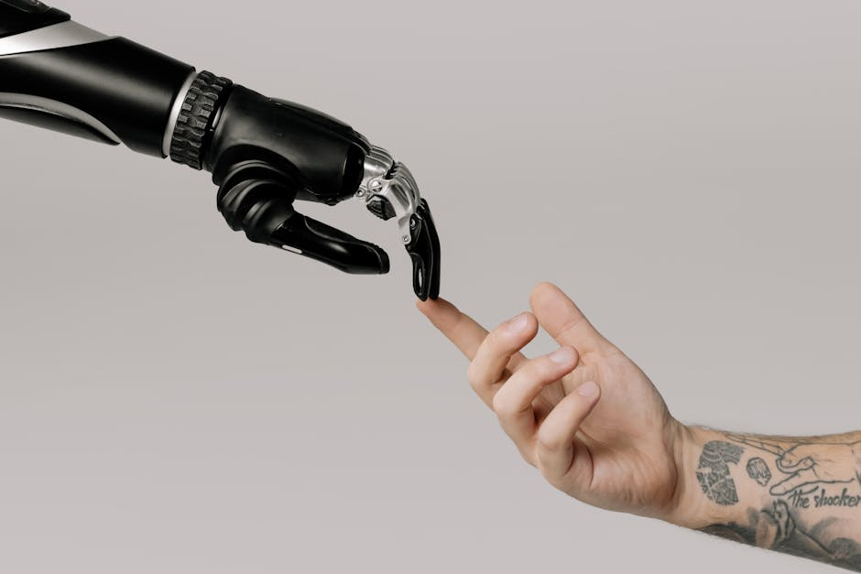
Challenges and Difficulties Faced
Dataset Limitations
Data imbalance and lack of high-quality labeled images made training deep learning models challenging.
Computational Complexity
Deep learning models require high computational power, making real-time classification difficult on low-end devices.
Generalization Issues
Models sometimes struggle to classify mixed-breed dogs or images taken from unusual angles.

Slide 9
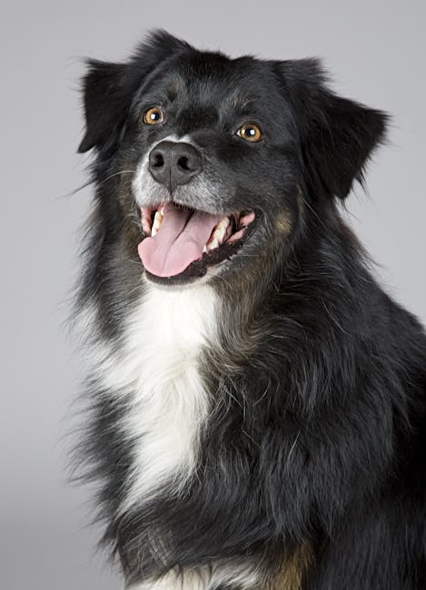
Outputs/ Screenshots

Slide 10
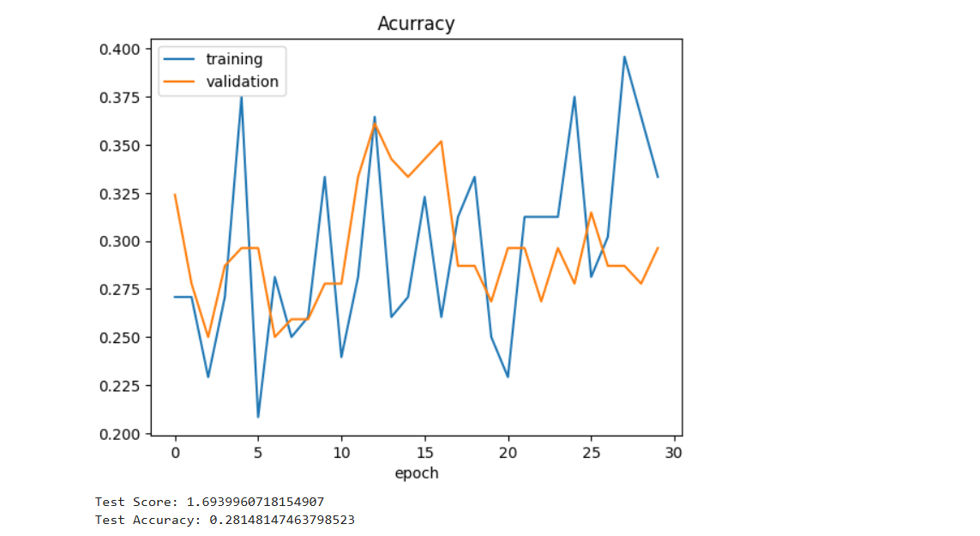
Outputs/ Screenshots

Slide 11
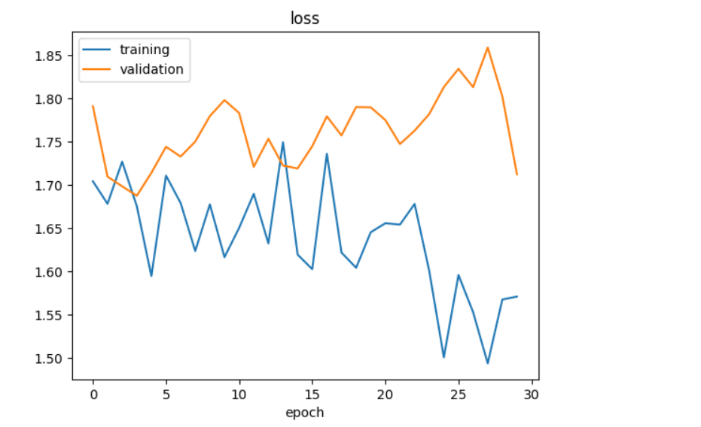
Outputs/ Screenshots

Slide 12
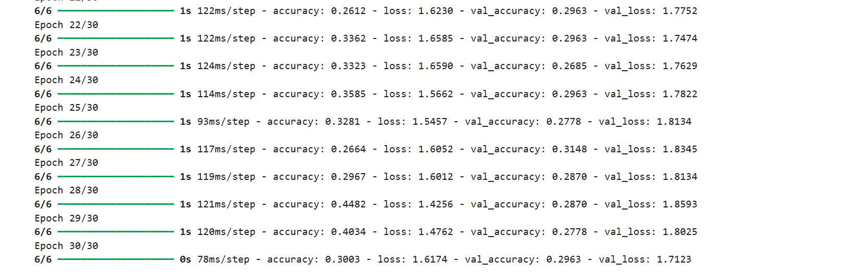
Outputs/ Screenshots

Slide 13
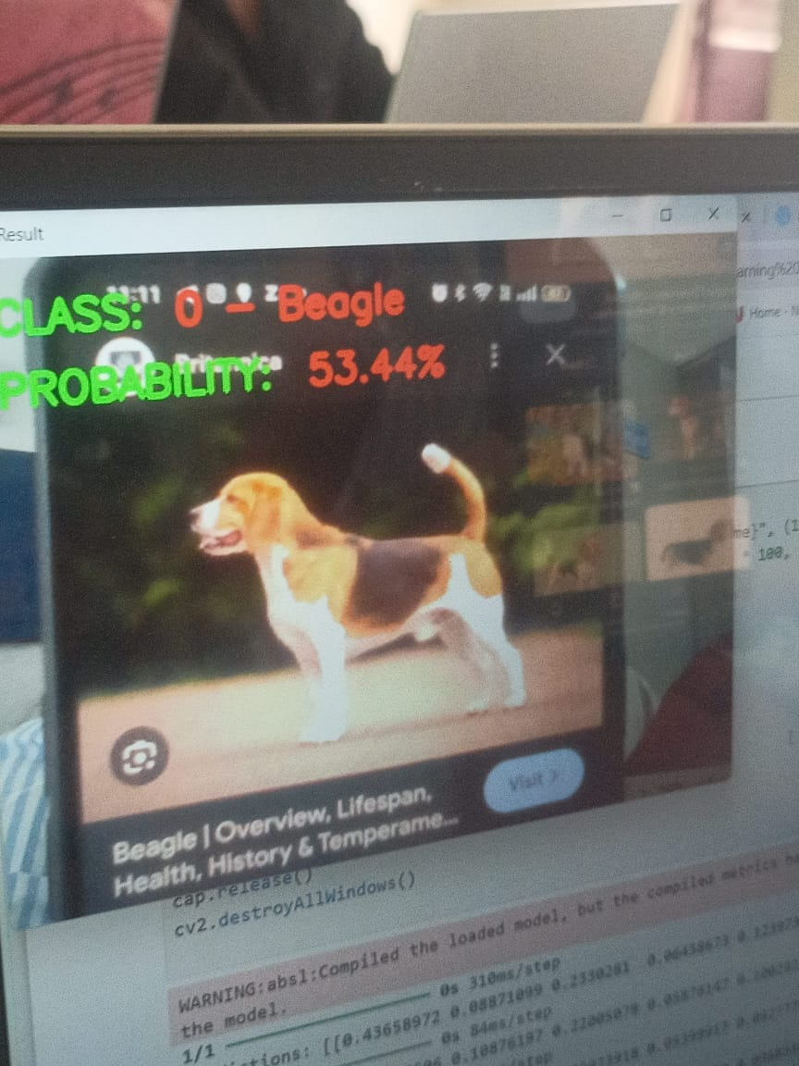
Outputs/ Screenshots

Slide 14

Improving Accuracy
Future models will focus on using larger datasets and more robust architectures to enhance classification accuracy.
Future Directions
Additionally, lightweight deep learning models will be optimized for mobile and edge computing to enable real-time breed identification.

Slide 15
Final Thoughts
What Did We Learn?
Conclusion
Deep learning has significantly improved dog breed identification by automating feature extraction and enhancing accuracy. However, challenges like dataset limitations and computational costs remain. Future improvements will focus on better models and real-time applications.

Slide 16
Q&A Session
Any Questions?
Thank You!
Thank you for your time! Feel free to ask any questions regarding the project.

